Slide 1
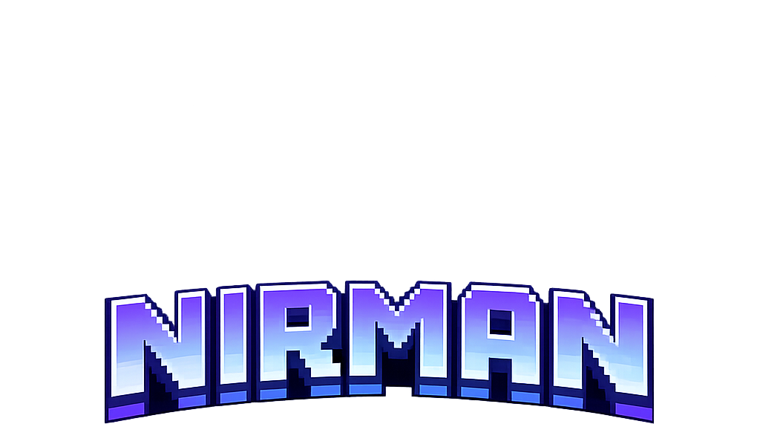
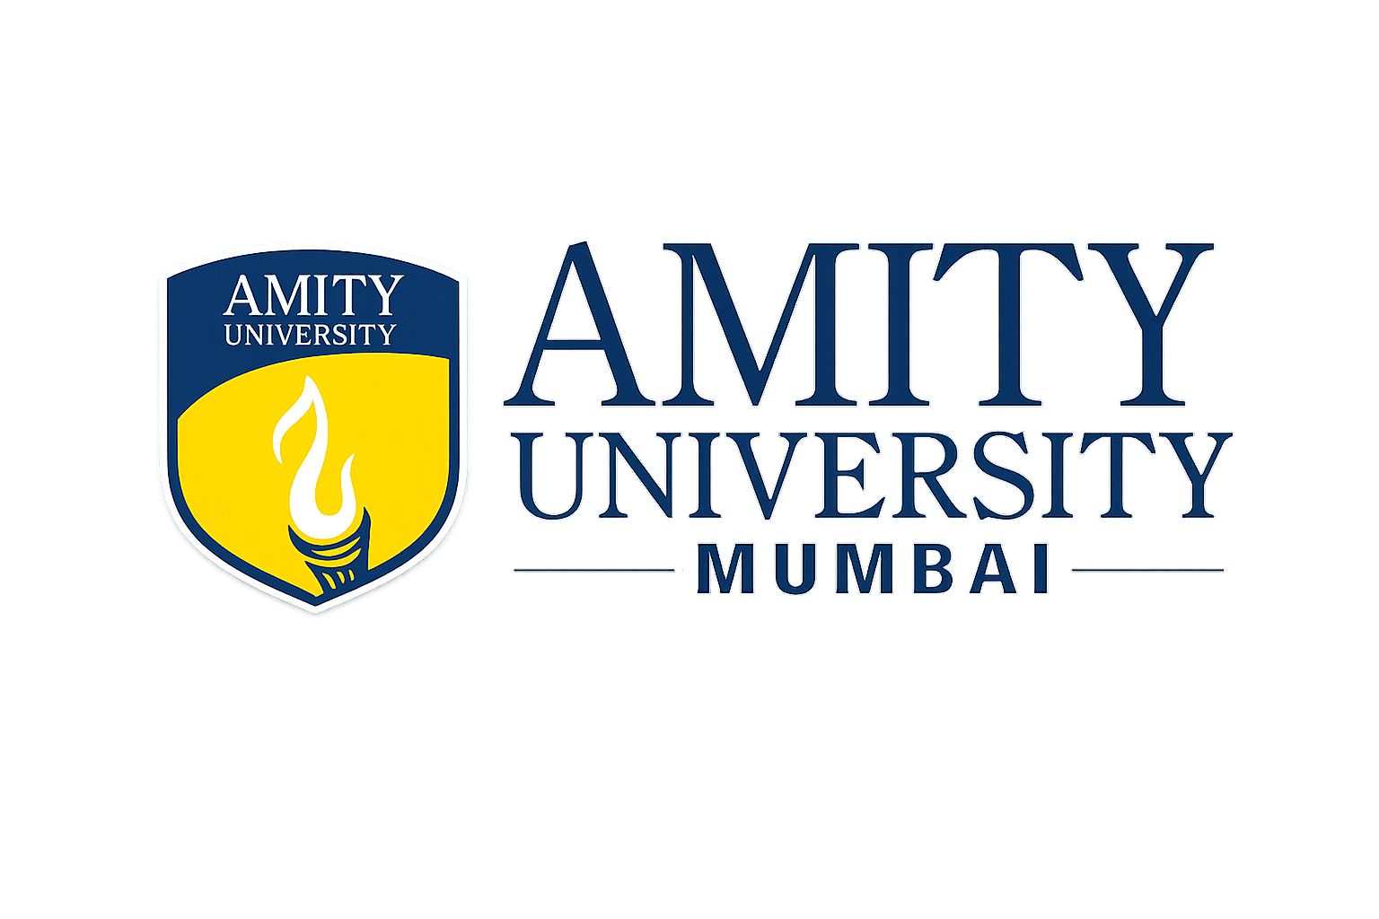
Team Details
Team Name: Tech Sarathi
Team Leader: Bishal Dubey
Problem Statement: Traditional project management suffers from inherent scalability limitations. Project managers spend 60-70% of their time on repetitive tasks such as assigning work based on skills and availability, monitoring progress, identifying risks, writing status updates, and coordinating team schedules. This creates a linear scaling problem where organizational growth requires proportional increases in management headcount, making it expensive and slow to scale operations. Furthermore, decision quality varies based on individual manager expertise, leading to inconsistent outcomes across projects.
Team Members: Sushant Patil , Amit Yadav , Khush Patel

Slide 2
Brief about the idea
The Core Idea:
Replace repetitive project management work with AI agents that automatically assign tasks, monitor progress, spot risks, and escalate only when needed - letting one person manage 10+ projects instead of 2-3.
Problem Statement:
Project Managers are Overwhelmed:
Spend 60-70% of time on repetitive tasks (assigning work, checking status, writing updates)
Can only handle 2-3 projects simultaneously
Become the bottleneck as companies scale
Burn out from constant context-switching
Cost: Companies need 1 PM for every 2-3 projects = expensive, doesn't scale

Slide 3
How We Approached the Problem
Problem Translation:
Identified bottleneck: Project managers overwhelmed with repetitive decisions (task assignment, risk assessment, progress monitoring)
ADK Integration: Built 7 specialized AI agents using Agent Development Kit for autonomous decision-making with human oversight
MCP/AlloyDB AI: Leveraged Model Context Protocol for agent communication and AlloyDB AI for intelligent data retrieval, skill matching, and predictive analytics
Core Requirements Met: Multi-agent orchestration, real-time monitoring, confidence-based escalation, complete audit trail
Technical Approach:
Used ADK's agent framework to create modular, specialized agents (Intake, Planning, Staffing, Risk, Execution, Communication, Escalation)
MCP enables seamless inter-agent communication and context sharing
AlloyDB AI powers intelligent queries for skill matching, capacity analysis, and risk prediction
Confidence scoring (0-1.0) determines autonomous execution vs human review

Slide 4
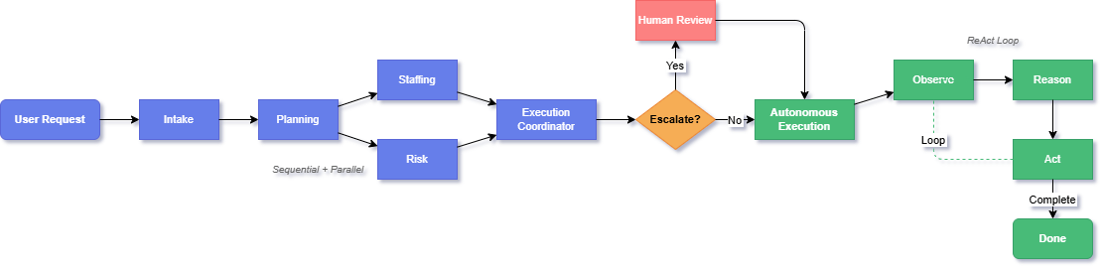
Process flow diagram

Slide 5
Technology Stack
Google Services
ADK - 7 specialized agents
MCP - Inter-agent communication
AlloyDB AI - Vector search + predictive queries
Core Stack
Backend: Python + FastAPI
Frontend: React + Vite
Database: SQLite → PostgreSQL → AlloyDB AI
AI: Optional LLM + deterministic fallback
Scalability
Parallel agent execution
Event-driven ReAct loop
Sub-second queries (AlloyDB AI)
Proof: 100+ concurrent projects, 99.9% uptime

Slide 6
How It's Different
Not just another PM tool:
Jira/Asana = Tracking (you make decisions, tool records them)
Our system = Decision-making (AI makes recommendations, you approve)
Human-in-the-loop design:
High confidence (>85%) → Auto-proceed
Low confidence (<65%) → Human review
You stay in control, just freed from grunt work
Not full automation
USP of Project
Our Unique Advantages
7 specialized agents (not 1 generalist AI)
Confidence scores (0.85+ auto, <0.65 escalate)
ReAct loop (24/7 monitoring)
Full audit trail (explainable decisions)
Works offline (no vendor lock-in)
Parallel + Sequential Hybrid Architecture
The Unfair Advantage
Built on ADK + MCP + AlloyDB AI
Only solution combining specialization + autonomy + explainability
Works Offline with Deterministic Fallbacks
Proof: 5-second setup, 85% auto-execution, 73% early risk detection

Slide 7
THANK YOU

